Slide 1
University Management System
University Management system is designed to automate the entire operations of a modern university.

Slide 2
iDev Solutions
Integrated Development Solutions provides innovative out of the box technological support and services that is reliable and cost-effective for small or large companies.
Our software development team operates with highly skilled, enterprising and multidisciplinary professionals from various spheres of expertise.

Slide 3
introduction
The University Management System (UMS) is a comprehensive innovative system for managing educational office activities of University.
Modules in UMS are fully integrated.
An unlimited number of users can be defined with in UMS.
UMS is a multi-divisional, multi-departmental and cost-center based suite of applications, which will practically cover the entire area of operations of the University.
The UMS is built using Microsoft .NET technology, driven at the back-end by using Microsoft SQL Server, which gives the application more power in security, scalability and maintainability.

Slide 4
Product Highlights
Manage multiple colleges comprising of multiple departments
Period-wise course catalogue permits to maintain different catalogue
Streamlined registration and admission activities
Organized college management involved in scheduling program, course and syllabus details
Define multiple fee policies for different year levels.
Supports sponsors and installments in fee management

Slide 5
Core Functionalities
University Management
Define and manage various programs and courses offered by the institutions
Supports by semester system
Maintain different schedules for programs/courses being conducted at various colleges
Supports templates for admission, exam, fees and grading techniques

Slide 6
UMS is the right choice for you
Here is why:
Tested and running for almost 1 year.
Proven to be stable.
Free lifetime updates.
It's WINDOWS based application
Notes:
s

Slide 7

Server Hardware Requirements
Intel Pentium IV – 2GHz or higher/any other compatible processor
1 GB RAM or higher
Minimum of 40 GB HDD space

Slide 8

Server Software Requirements
Microsoft Windows 2000 Advance server
Microsoft Word and Excel
TCP/IP
Internet Explorer 5.0 or higher
RDBMS (SQL Server 2000 or later)

Slide 9
Client Hardware Requirements
Intel Pentium IV 300 MHz or higher/any other compatible processor
256MB RAM or higher
Multimedia installed
Display resolution 1024x768 pixels, recommended
Minimum 2GB HDD space

Slide 10
Client Software Requirements
Microsoft Windows XP
Internet Explorer 5.0 or higher
Microsoft office
Macromedia flash player

Slide 11
Ums modules
University Management System

Slide 12
UMS Modules
Academic Components
Room Management & Subject Offering
ID Acquisition
Business and Finance Components
Cashiering Module
School Fee Module
Administrative Components
Employee Information System
Transaction Log
Teacher Loading
Academic Transaction
Collection Reports

Slide 13
Ums Highlights
University Management Solution

Slide 14
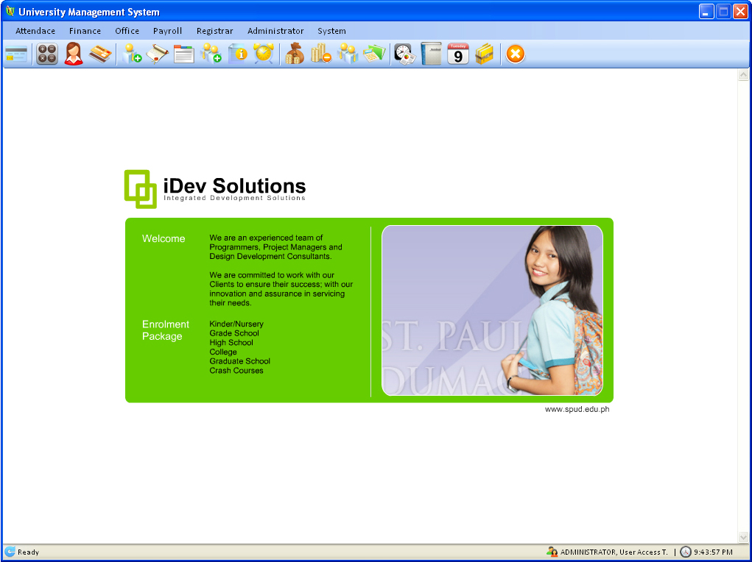
Main
Some text here

Slide 15
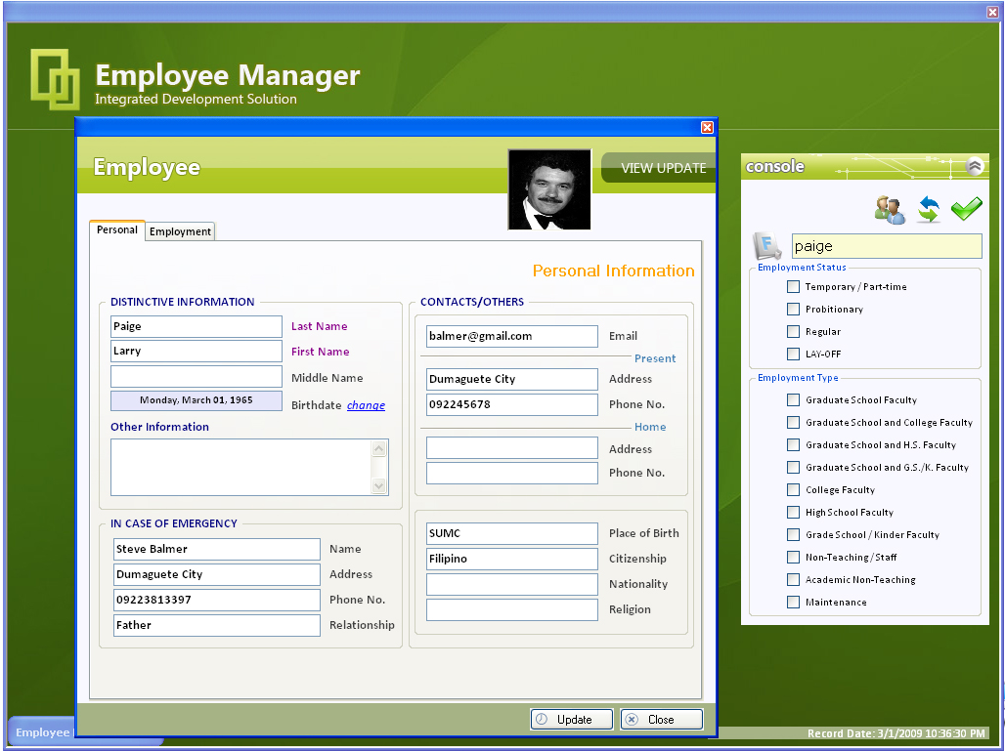
Employee Manager
Some text here

Slide 16
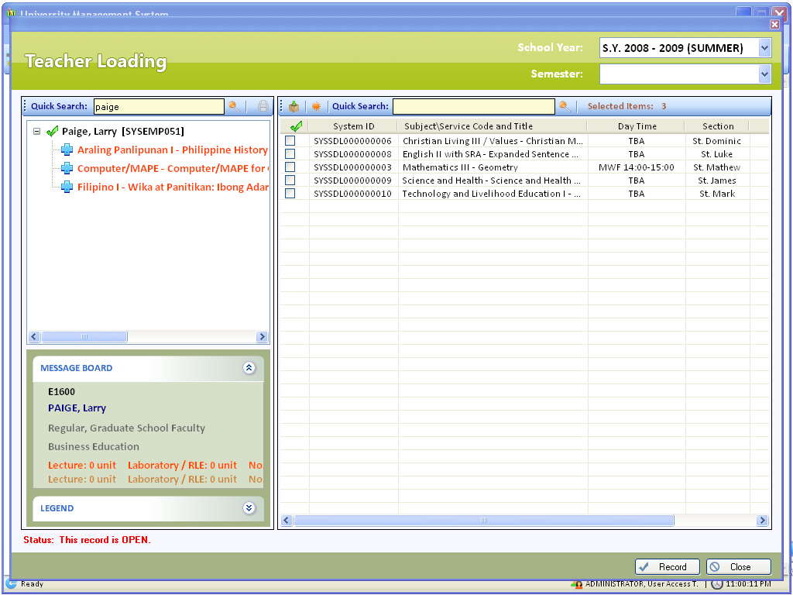
Teacher Loading
Some text here

